Slide 1

Microsoft AL
GUI & In-Client Designer II

Slide 2



Prerequisite
Use Workshop-VM / Workshop-Computer follow the instructions of the Boarding Pass
Visual Studio Code
https://code.visualstudio.com
Competence Team DevTech
Microsoft AL

Slide 3
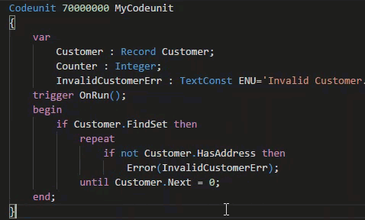
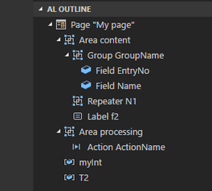
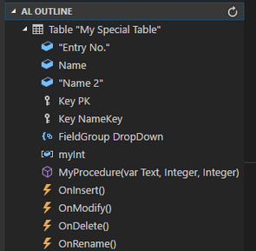
VS Code Useful Extensions
AL Formatter
Indentation
Keyword case style
Sort variable definitions
Readability Guidelines - Spacing and newlines (experimental)
AL Code Outline
Outlining – AL Object Structure
“Create List Page” from Table
“Create Card Page” from Table
al-util
“Rename & Move” Objects
Templates e.g. “Readme.md”

Slide 4
GUI & In-Client Designer Agenda
1
Language & Types (Re-Cap)
2
Pages, Page Extensions (Re-Cap)
3
Page Properties
4
Page Actions
5
Hands On

Slide 5

Microsoft AL
Language & Types
Page
Page Extension
Page Customization

Slide 6
Microsoft AL Language & Types
Recommendation for VS Code
1 File per Object
Organize Object Files in Folders (Pages, PageExtension, …)
Use Snippets in AL
ttable
tpageext
tcodeunit
…
Documentation - Development in AL
https://docs.microsoft.com/.../developer/devenv-dev-overview
C/Side | Microsoft AL
 | Extending | New
Codeunit | - | codeunit
Table | tableextension | table
Page | pageextension pagecustomization | page
XMLport | - | xmlport
Query | - | query
Report | - | report
Menu Suite | - | -
 |  | profile
 |  | controladdin

Slide 7
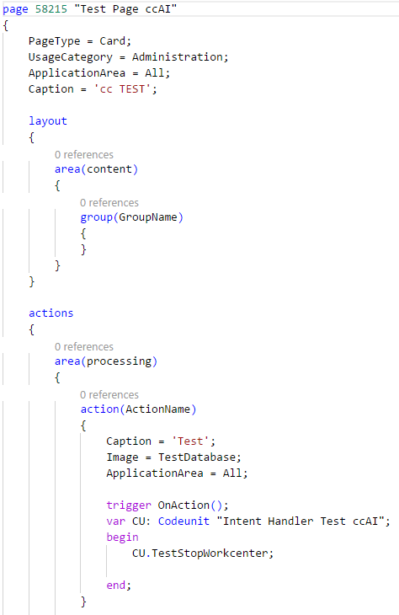
Microsoft AL Page
page <ID> „<Unique Name>“
Content Structure
Page Properties
Layout Section
Actions Section
Global Variables
Procedures & Events & Page-Triggers
Sections
Layout → Areas → Groups → Group-Properties & Fields → Field-Properties & Triggers
Action → Areas → Area-Properties & Actions → Action-Properties & Trigger

Slide 8
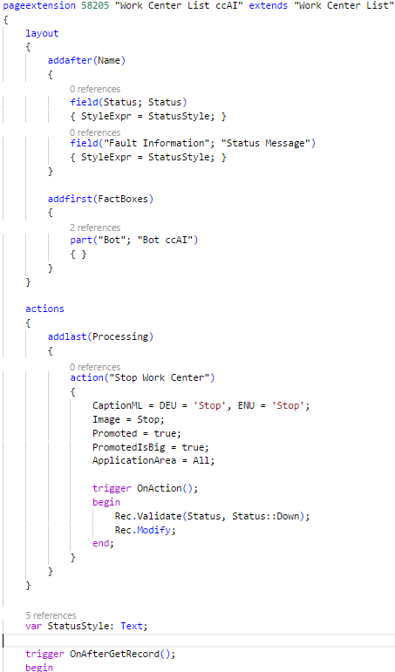
Microsoft AL Page Extension
pageextension <ID> “<Unique Name>” extends “< Target Page Name>” / or <ID>
Extensions / Modifications
Add addfirst(<ID>), addbefore(<ID>), addafter(<ID>), addlast(<ID>)
Move movefirst(<ID>), movebefore(<ID>), moveafter(<ID>), movelast(<ID>)
Modify modify(<ID>)
Changes in Sections
Layout → <Extension/Modification> → new / changed page content
Action → <Extension/Modification> → new / changed page actions
Additional Content
Global Variables
Procedures & Events & Page-Triggers

Slide 9
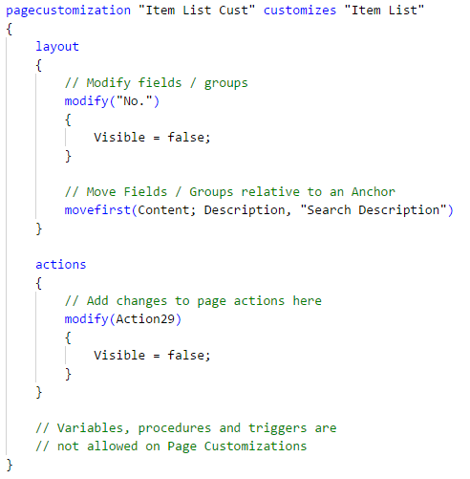
Microsoft AL Page Customization
pagecustomization “<Unique Name>” customizes “<Target Page Name>” / or <ID>
Modifications
Move movefirst(<ID>), movebefore(<ID>), moveafter(<ID>), movelast(<ID>)
Modify modify(<ID>)
Changes in Sections
Layout → <Modification> → changed page content
Action → <Modification> → changed page actions
No Additional Content!!!

Slide 10

Pages in Microsoft AL
Microsoft AL Page Design
Page Properties
Layout, Action, Triggers

Slide 11
Microsoft AL Page Properties
PageType
Card, List, RoleCenter, Card Part, List Part, API, …
SourceTable / SourceTableView
SourceTableView = order(ascending) where (Code = const(‘PROD'));
ApplicationArea Application Area for the Page WebClient SearchPage
All, Basic, Suite, Advanced
UsageCategory Department for the Page WebClient SearchPage
None, Lists, Tasks, ReportsAndAnalysis, Documents, History, Administration
CardPageId

Slide 12
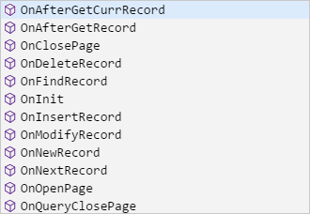
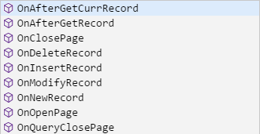
Microsoft AL Page / Page Extension - Triggers
Page - Triggers (Picture 1)
Same Triggers as in C/Side
Page Extension - Triggers (Picture 2)
less Triggers as Pages
Microsoft: “…triggers are called "closer" to the original trigger than the events…”

Slide 13
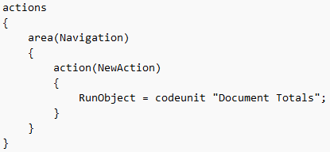
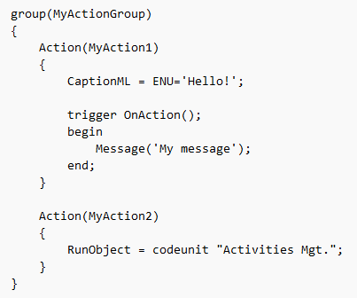
Microsoft AL Page Actions
Properties equal to C/Side
Image
Promoted / PromotedOnly / PromotedIsBig / PromotedCategory
Ellipsis
ApplicationArea All, Basic, Suite, Advanced
InFooterBar (Wizards)
RunObject & RunPageView RunObject = page “Target Page” RunPageView = order(ascending) where(“Target Rec Field" = field(“Source Field"));
Trigger
OnAction();

Slide 14
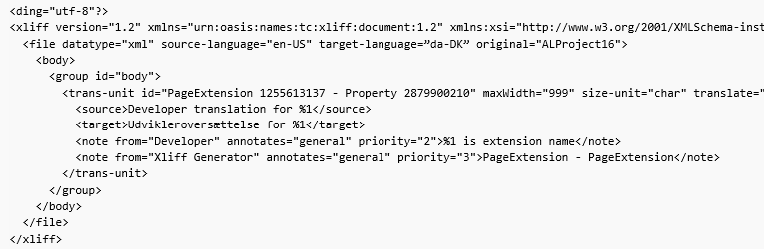
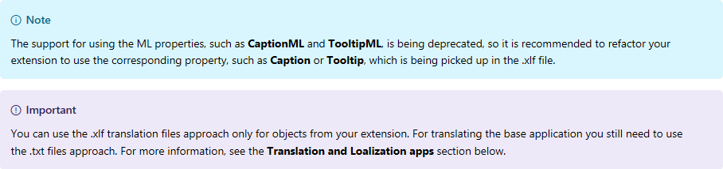
Microsoft AL Multi Language Properties
CaptionML, TooltipML, InstructionalTextML, …
Deprecated
XLIFF
XML Localization Interchange File Format
Working with Translation Files
Editor
Multilingual App Toolkit 4.0 Editor

Slide 15

It’s Lab Time
Hands On
New Pages
New Extensions

Slide 16
Pages in Microsoft AL Hands On
Material
Project Skeleton „02-GUI-&-In-Client-Designer\Starter\02 My Favorite Beer\”
Tables: “Beer Category”
Tables.Extensions: “Customer”, “Item”
Prerequisites
Connect to your Workshop VM → use Instructions on your Workshop Boarding Pass
Hand On - Tasks
Create a Card Page and a List Page for Table “Beer Category”
Create a Page Extension (Card) for Table Extension “Customer”
Create a Page Extension (Card) for Table Extension “Item”

Slide 17
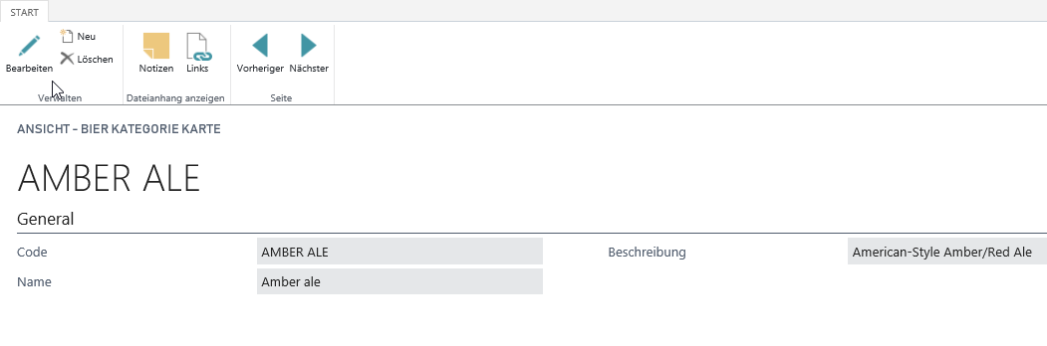
Pages in Microsoft AL Hands On – Card Page
Create a Card Page „Beer Category Card [CC]“ ID: 50201
Setup the Properties for the Page
PageType Card
UsageCategory Documents
ApplicationArea All
SourceTable „Beer Category [CC]“
SourceTableView sorting: „Code“ order: ascending
CaptionML ENU + DEU
Layout
Add all fields of the table to the layout area „content“ in a group „General“
Setup field properties (e.g. ApplicationArea)

Slide 18
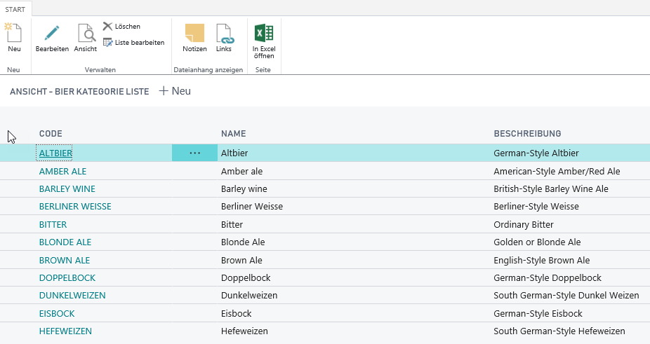
Pages in Microsoft AL Hands On – List Page
Create a List Page „Beer Category List [CC]“ ID: 50202
Setup the Properties for the Page
PageType List
UsageCategory Lists
ApplicationArea All
SourceTable „Beer Category [CC]“
SourceTableView sorting: „Code“ order: ascending
CaptionML ENU + DEU
CardPageId "Beer Category Card [CC]“
Layout
Add all fields of the table to the layout area „content“ in a repeater „General“
Setup field properties (e.g. ApplicationArea)

Slide 19
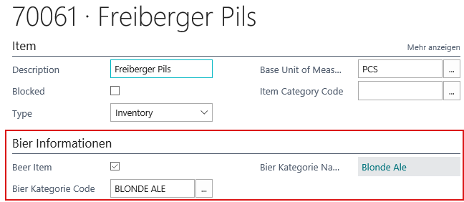
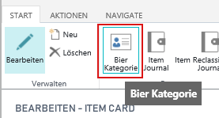
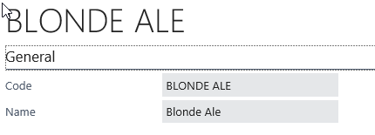
Pages in Microsoft AL Hands On – Page Extension
Create a Page Extension „Item Card [CC]“ extends “Item Card” ID: 50200
Layout
Add a group “Beer” behind the “Item” group
CaptionML ENU + DEU
Add the “Beer” fields
Hide “Beer Category Group“ & „Beer Category Group Name“, when the item is not marked as „Beer Item“
Actions
Add an action to show the “Beer Category Card“
Use Properties: CaptionML, ApplicationArea, Visible, RunObject, RunObjectView, Promoted, Image

Slide 20
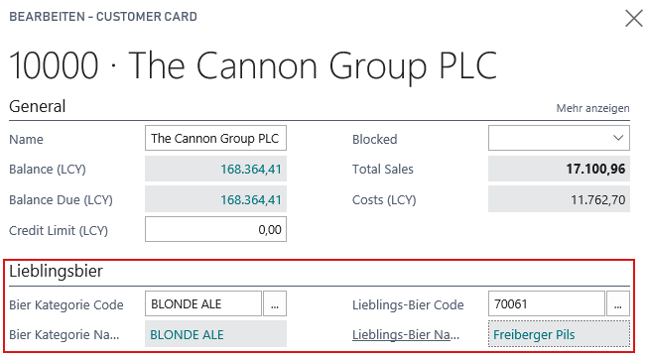
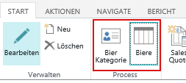
Pages in Microsoft AL Hands On – Page Extension
Create a Page Extension „Customer Card [CC]“ extends “Customer Card” ID: 50201
Layout
Add a group “Favorite Beer” behind the “General” group
CaptionML ENU + DEU
Add the “Beer” fields from record “Customer”
Actions
Add an action to show the “Beer Category Card“
Add an action to show the possible “Beer Items“

Slide 21

Q & A
Visual Studio Code
https://code.visualstudio.com
Competence Team DevTech
Channel Microsoft AL

